Slide 1
Designing a Publishing Site
WCM features in SharePoint Server 2010
Notes:
The lecture focuses on the Web Content Manage (WCM) features offered by Publishing Sites in SharePoint Server 2010. You will learn how Publishing sites provide extended functionality for content authoring, content approval, site branding and overall page design using Publishing page. There will be a discussion about information architecture and designing a taxonomy of sites which makes it easier for users to search for and navigate to the information they need. The lecture will also demonstrate how to leverage the built-in support in Publishing sites for uploading and integrating custom master pages and CSS files and for tuning the navigation settings on a site-by-site basis.

Slide 2
Agenda
Introduction to Publishing Sites
Publishing Site Taxonomy
Adding Pages and Sites
Configuring a Custom Master Page
Customizing Navigation

Slide 3
Overview of SharePoint WCM
SharePoint WCM based on Publishing sites
Site collection requires publishing site as top-level site
Created using site template named Publishing Portal
Publishing sites used for public Internet Websites
Infrastructure for collecting and publishing content
Includes built-in content approval process
Includes built-in support for branding
Notes:
The functionality for Web Content Management (WCM) in SharePoint 2010 based on Publishing sites. Using this functionality involves create a new site collection and using the Publishing Portal site template to create the top-level site.
The functionality and appearance of a publishing site was created to support publically facing sites on the Internet. Publishing sites provide an infrastructure for collecting and publishing content including a built-in content approval process and built-in support for branding

Slide 4
Publishing Site Functionality
Functionality discussed in this course
Collecting, structuring, styling & publishing site content
Support for integrating custom master pages
Support for integrating custom CSS files and images
Support for customizing navigation menus
Other functionality not discussed in this course
Controlling content approval with custom workflows
Translating content to other languages with variations
Improving performance via output caching
Configuring security using pre-defined publishing roles
Notes:
It is not feasible to discuss all the functionality that is included with publishing sites in a branding courses such as this. However, there are several topics concerning branding with publishing sites that will be discussed in this course including collecting, structuring, styling and content in a publishing site. The course will also discuss integrating custom master pages, CSS files and images as well as the extra support for navigation.
There are other topics concerning publishing sites that are beyond the scope of a class like this that focuses on branding. These topics include controlling the content approval with custom workflows, translating content to other languages using variations, improving performance via output caching and configuring security using pre-defined publishing roles.

Slide 5
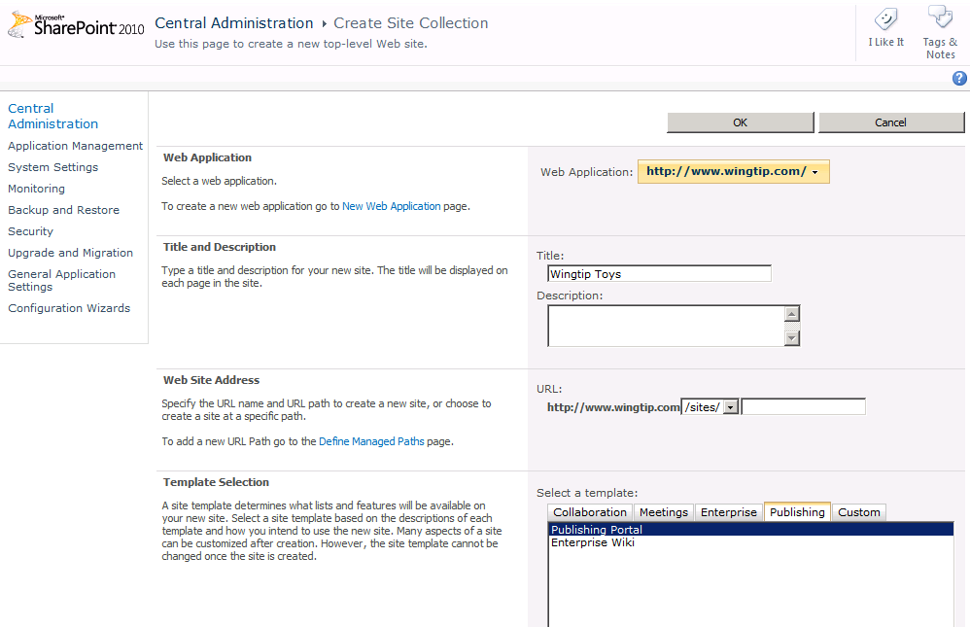
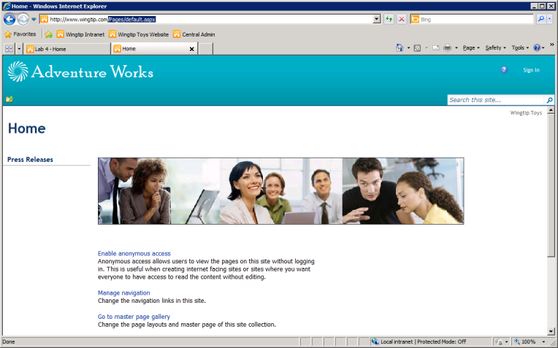
Creating a Publishing Site
Created using the Publishing Portal template
Creates site collection with publishing features enabled
Notes:
To create a new publishing site collection using Central Administration, you can use the Publishing Portal template available under the Publishing tab. When you create a new publishing site, SharePoint 2010 automatically activates the appropriate publishing features.
If you would rather create a new publishing site collection in an automated fashion, you can accomplish this with the follow Windows PowerShell script.
Add-PSSnapin "Microsoft.SharePoint.Powershell" -ErrorAction "SilentlyContinue"
$SiteTitle = "Wingtip Toys"
$SiteCollectionOwner = "WINGTIP\ken"
$SiteUrl = "http://www.Wingtip.com"
$SiteTemplate = "BLANKINTERNETCONTAINER#0"
New-SPSite -URL $SiteUrl -OwnerAlias $SiteCollectionOwner -Template $SiteTemplate

Slide 6
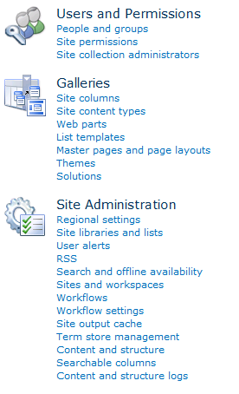
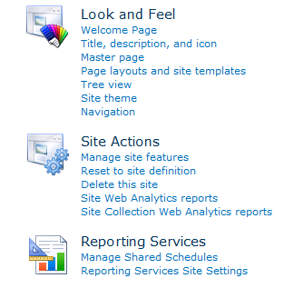
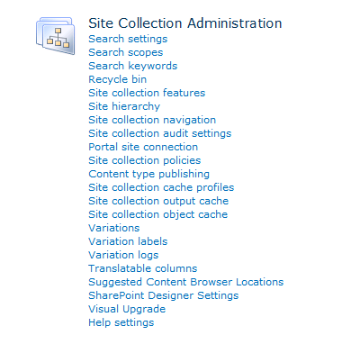
Site Settings
Site Setting extended with extra functionality
Notes:
If you navigate to the Site Setting page of the top-level site in a publishing portal, you will see it contains quite a few extra links and additional functionality that is not included in standard team sites. We will discuss much of the functionality in this lecture and the next leecture.

Slide 7
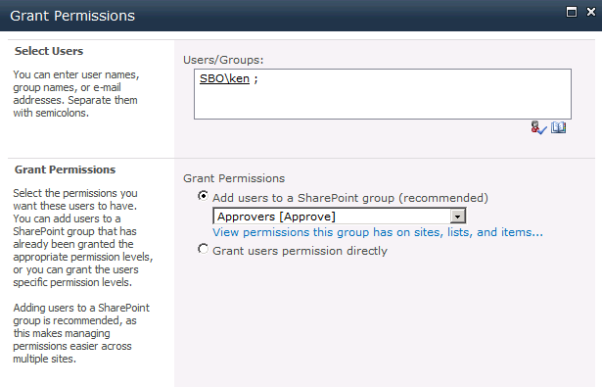
Security Gotcha!
No default permissions for approving sites and pages
This is true even for site collection owner
At first, you will not be able to approve sites or pages
Add appropriate users to the Approvers group
Gives you permissions required to approve content
Allows you to add and approve child sites and pages
Notes:
There is a security issue that trips people up when working with publishing sites. That is because they usually assume that they can do anything if they are configured as a site collection owner or a site administrator. However, that is not enough when it comes to approving child sites and publishing pages. You must be a member of the Approvers group or you will fail in your attempts to approve child sites and publishing pages. The reason for this is that the requirement of being a member of the Approvers group is hardcoded into the standard workflow behind the Pages document library.

Slide 8
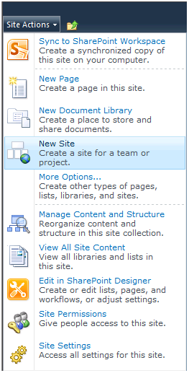
Adding Content Using Site Actions
New Page
Adds new publishing page to current site
New Site
Adds child site to current site
Notes:
The Site Actions menu in publishing sites is extended with 2 commands for adding content
New Page - used to add a new publishing page to the Pages library in current site
New Site - used to add new child site to current site

Slide 9
Adding Sites
You construct site hierarchy by adding child sites
Each site gets a landing page (/Pages/default.aspx)
Secondary publishing pages added to site as needed
Child publishing sites added to each site as needed
Publishing pages can be structured into folders
Allows you to scale to 1000s of pages per site
Some OOB functionality only available to pages at root
Notes:
When it is time to design the content for a new a publishing site collection, you construct site hierarchy by adding child sites. Each site that is added gets a landing page inside the Pages document library named default.aspx. By default, this landing page is configured as the home page for the new child site. Once you have created a new site, you then add extra publishing pages as needed.
Starting with SharePoint 2010, publishing sites support adding new publishing pages to folders created inside the Pages document library. By using folders efficiently, you can scale a single publishing site to contain 100s or even 1000s of pages. However, it should be noted that some of the stock functionality such a having SharePoint 2010 automatically provide navigational menus to publishing pages is only available to publishing pages at the root of the Pages document library.

Slide 10
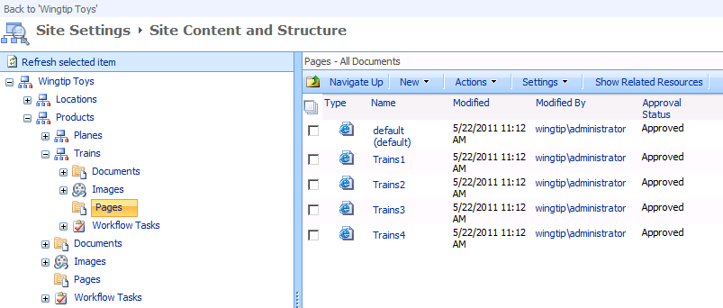
The Content and Structure Page
Administrative page to view and manage content
Easy to find sites & pages to edit, approve or delete
Page renders with SharePoint 2007 User Interface strange but true
Notes:
SharePoint 2010 provides a complex application page known as the Site Content and Structure page that has been carried over from SharePoint 2007. This page provides a high-level view of the site collections structure and provides a quick way to view, configure and administrate sites and pages as well as other files such as CSS files and images.
Note that the Site Content and Structure page renders with SharePoint 2007 User Interface. It is probably not worth your while trying to style or brand this page because it would involve a considerable amount of work for a one off effort to brand a single page that is never seen be anyone other than site administrators.

Slide 11
DEMO
Getting Around in a new Publishing Portal

Slide 12
Agenda
Introduction to Publishing Sites
Publishing Site Taxonomy
Adding Pages and Sites
Configuring a Custom Master Page
Customizing Navigation

Slide 13
Information Architecture
High-level design of site content is important
Big impact on branding, presentation, navigation, etc.
Best practice to design taxonomy for content structure
Wingtip Toys
Store Locations
Products
Trains
Planes
Notes:
A crucial aspect of designing a publishing site collection is creating the high-level structure for the hierarchy of sites and pages. The hierarchy you come up with will have a significant impact on issues such as branding, presentation and navigation. It is recommended that you think through the important issues and design a taxonomy to reflect the structure of the content to be shown.

Slide 14
High-level View of a Publishing Portal
A structured hierarchy of sites and pages
\ (root site)
\Pages
\default.aspx
\contact.aspx
\about.aspx
\Locations (child site)
\Pages
\default.aspx
\tampa.aspx
\jacksonville.aspx
http://www.wingtiptoys.com/Pages/default.aspx
Top-site home page
http://www.wingtiptoys.com/Pages/contact.aspx
Top-site secondary page
\Products (child site)
requests
\Pages
\default.aspx
\trainst.aspx
\planes.aspx
http://www.wingtiptoys.com/Locations/Pages/Tampa.aspx
Locations site secondary page
http://www.wingtiptoys.com/Products/Pages/defaulkt.aspx
Products site home page
\Trains (child site)
http://www.wingtiptoys.com/Products/Trains/Pages/train1.aspx
Products child site secondary page
\Pages
\default.aspx
\train1.aspx
\train2.aspx
\Planes (child site)
\Pages
\default.aspx
\plane1.aspx
\plane2.aspx
Notes:
When you design the hierarchy of sites and pages, you are also committing to the structure which determines the URL to each page. The slide above shows a hierarchy of sites where different types of products have been factored out into their own child sites such as Trains and Planes. This adds the product category into the URL of each product pages and provides a better way to take advantage of the out-of-the-box support for navigation.

Slide 15
Designing A Site Hierarchy
Publishing site modeled as hierarchy of sites
You choose how many levels of child sites
Which is Better?
Small # of sites containing large # of pages
Large # of sites containing small # of pages
Best to model taxonomy nodes using child sites
Each child site can have unique master page
Each child sites creates node in global navigation
Notes:
A publishing site collection is modeled as hierarchy of child sites. It is your job to determine how many levels of child sites is best.
Do you want a site collection with just a few child sites but where each child site has 100s or possibly 1000s of publishing pages? Or is it better to create a site collection with more child sites but where each child site has a lower, more manageable number of publishing pages. There is no one answer that is right for every situation.
It is a common design technique to model taxonomy nodes using child sites. For example, instead of having a single site with 1000 publishing pages, you could have three levels of sites in which the bottom level has 100 child sites with 10 publishing pages each. This would allow each publishing page to have its own node in global navigation. Also remember that each child site can have its own master page. If you factor the publishing pages for trains and planes out into separate sites, you could have one master page for trains and a separate master page for planes.

Slide 16
Lists Automatically Created in Publishing Sites
Add only to top-level Publishing site
Used on a site collection-wide basis
Add to each and every Publishing site
List | List Type
Form Templates | Document Library
Site Collection Documents | Document Library
Site Collection Images | Document Library
Style Library | Document Library
Content and Structure Reports | Standard List
Reusable Content | Standard List
List | List Type
Documents | Document Library
Images | Document Library
Pages | Document Library
Workflow Tasks | Standard List
Notes:
When you create a new publishing portal, the publishing features always create the following document libraries in the top-level site.
Form Templates
Site Collection Documents
Site Collection Images
Style Library
Likewise, the publishing features create the following list in every top-level site
Content and Structure Reports
Reusable Content
In addition to what is created in the top-level site, the publishing features create the following document libraries in every site regardless of whether it is a root site or child site.
Documents
Images
Pages
Finally, the publishing features always create the following list in every site regardless of whether it is a root site or child site.
Workflow Tasks

Slide 17
DEMO
Creating a Taxonomy using Child Sites

Slide 18
Agenda
Introduction to Publishing Sites
Publishing Site Taxonomy
Adding Publishing Pages
Configuring a Custom Master Page
Customizing Navigation

Slide 19
The Publishing Approval Process
How does the Publishing approval process work?
Content author creates publishing pages
Content author selects page layout for page
Content author adds and edits page content
Content author submits page for approval
Content manager reviews page then approves/rejects
Approval is not just required for publishing pages
Master pages and page layouts
Files uploaded to Style Library
Files uploaded to Documents
Notes:
The publishing approval process is based on the following steps
A content author creates a publishing page
The content author goes into edit mode and selects page layout for page
The content author adds content and edits this content as needed
The content author submits page for approval
A content manager who is a member of the Approvers group reviews page then approves/rejects
Approval is not just required for publishing pages. It is also required for master pages and page layouts that have been uploaded with the browser or added using SharePoint Designer.
You must also pay attention to files uploaded to the Style Library and the document library named Documents. While these files do not have to go through the approval process, they do have to be checked in and published as a major version (e.g. version 1.0).

Slide 20
Selecting the Page Layout
Publishing sites provide collection of page layouts
Each publishing page based on a specific page layout
Publishing site configured with default page layout
Content author can select a different page layout
Learn the Page Layouts that ship out of the Box
Notes:
Publishing sites provide a collection of page layouts in the master page gallery. Note that a publishing page can be used in the site where it is located as well as in any child site located below it in the site hierarchy. That means page layouts in the master page gallery can be used on a site collection wide basis.
Each publishing page is configured to use a specific page layout. The top-level site and each child site can be configured with default page layout. A child site can also be configued to hide page layouts from its parents sites to ensure content authors only select page layouts that are appropriate for the content in that site.
It is recommended that you learn the page layouts that ship out of the box that are discussed on the next slide.

Slide 21
OOB Page Layouts
Welcome Pages
BlankWebPagePage.aspx
WelcomeLinks.aspx
WelcomeSplash.aspx
WelcomeTOC.aspx
Article Pages
ArticleLeft.aspx
ArticleRight.aspx
ArticleLinks.aspx
PageFromDocLayout.aspx
Enterprise Wiki Page
EnterpriseWiki.aspx
Project Page
ProjectPage.aspx
Redirect Page
VariationRootPageLayout.aspx
Notes:
There are several page layouts with columns for landing pages.
BlankWebPagePage.aspx
WelcomeLinks.aspx
WelcomeSplash.aspx
WelcomeTOC.aspx
There are also page layouts with columns for information in informational articles.
ArticleLeft.aspx
ArticleRight.aspx
ArticleLinks.aspx
PageFromDocLayout.aspx
There is a single page layout that can be used for Enterprise Wiki Page which is named EnterpriseWiki.aspx. There is a There is a single page layout that can be used for various types of projects named ProjectPage.aspx. There is also a page layout which serves the purpose of acting as a redirect page named for the variations framework named VariationRootPageLayout.aspx.

Slide 22
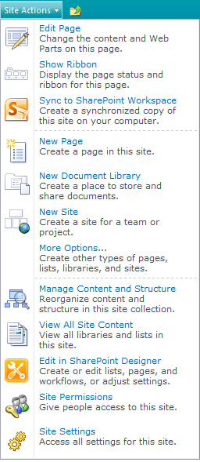
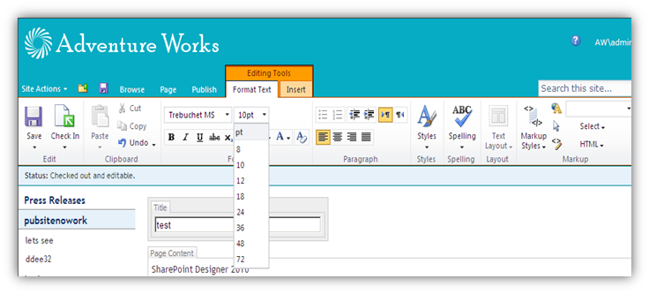
Editing Content in a Publishing Page
Notes:
Creating new publishing pages has been streamlined in SharePoint 2010. Unlike in SharePoint 2007, content owners can create a new page from the Site Actions menu and specify a page name without selecting a content type or page layout. SharePoint 2007 required you to select a page type (content type) and page layout at creation time.
Once the publishing page has been created, the content author can then switch between content types & page layouts after the page has been created on the fly using the Page Layout button command in the Pages tab in the ribbon.
It is nice that all content authoring controls have been added to the ribbon. The rich text editor is now cross-browser friendly and generates well-formed XHTML. Additional tools in the ribbon (Editing Tools » Format Text) assist with converting HTML to well-formed XHTML.

Slide 23
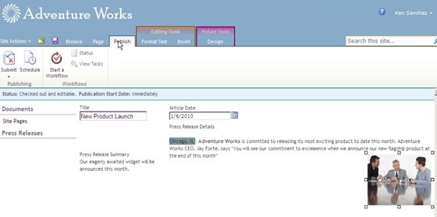
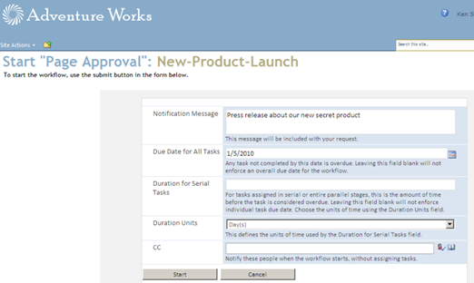
Publication Approval Process
Publish process kicks off the workflow
Notes:
The ‘Publishing Site with Workflow’ site template comes out-of-the-box with a built in workflow called Page Approval which is configured on the Pages document library and is also readily modifiable using the browser.
The base workflow template for this workflow is Publishing Approval Workflow which works very similar to the Approval workflow. The Approval workflow is for approving documents while the Publishing Approval workflow acts on pages.

Slide 24
DEMO
Creating and Approving Publishing Pages

Slide 25
Agenda
Introduction to Publishing Sites
Publishing Site Taxonomy
Adding Pages and Sites
Configuring a Custom Master Page
Customizing Navigation

Slide 26
Uploading a Custom Master Page
Master Page uploaded to Master Page Gallery
Assign Content Type of Master Page on upload
Check it as a Major Version (e.g. version 1.0)
Approve it
Master Pages CSS files uploaded to Style Library
Includes images used by CSS file as well
CSS files and images require check in as major version
Files in Style Library do not require approval process
Notes:
To use a custom master page, you must first upload it to the Master Page Gallery. When you do you should assign it a content type of Master Page to differentiate it from page layouts which are also stored in the Master page gallery. Before you can use a master page, you must also check it as a Major Version such as version 1.0 and then approve it. You will work through these steps in the lab exercises associated with this module.
To use a custom CSS file, you can upload it to the Style Library. You will find that it works well if you also upload the images used by the CSS file into a folder in the Style Library under the CSS file. Note the files inside the Style Library are not like master pages because they do not require approval. However, they require check in as major version.

Slide 27
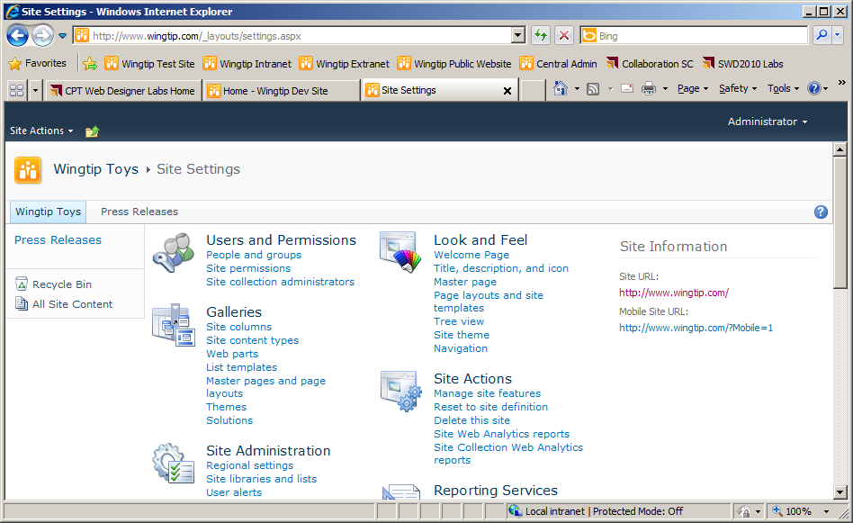
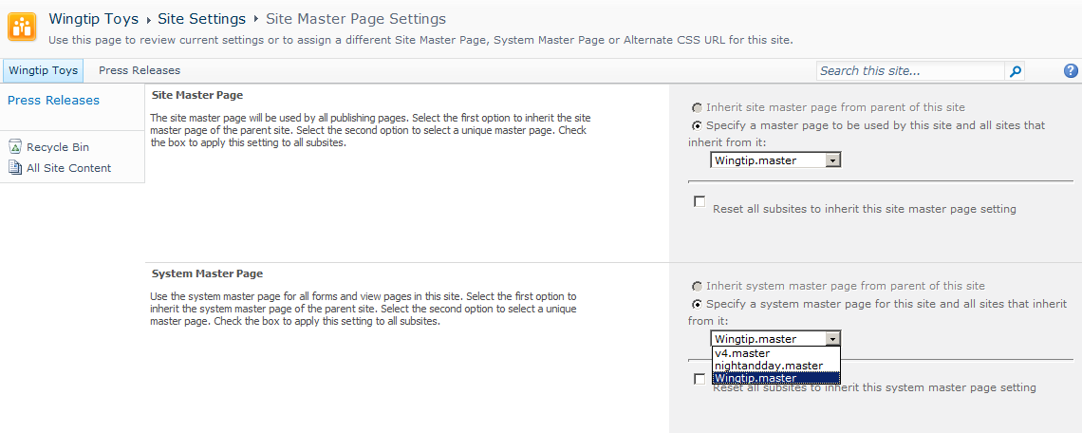
Configuring a Custom Master Page
Notes:
This slide shows the places in a SharePoint User interface designed to allow you to configure a custom master page. Note that the Site Master Page Settings page differentiates between these two types of master pages.
Site Master Page
System Master Page
The Site Master Page setting is what configures the master page for all publishing pages. In other words, it configures the master page for all pages served out of the Pages library.
The System Master Page setting is what configures the master page for all pages other than publishing page. This means it configures the master page for all application pages as well as the pages associated with standard list such as AllItems.aspx.

Slide 28
DEMO
Uploading and Configuring Master Pages

Slide 29
Agenda
Introduction to Publishing Sites
Publishing Site Taxonomy
Adding Pages and Sites
Configuring a Custom Master Page
Customizing Navigation

Slide 30
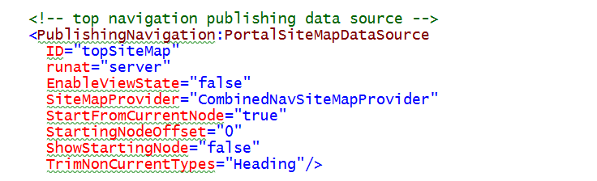
Navigation in a Publishing Portal
Navigation is different in Publishing site
Makes navigation easier to configure and customize
Relies on specialized publishing navigation providers
Navigation providers substituted using delegates
Custom provider used for Topnav and QuickLaunch
Notes:
The data sources used to retrieve the navigation nodes are different in Publishing site. SharePoint Server 2010 makes this modification to publishing sites to make navigation easier for users to configure and customize through the browser. Publishing sites rely on specialized navigation providers such as the PortalSiteMapDataSource shown in the slide above.
With standard master pages such as v4.master which can be used with either team sites or publishing sites, these specialized navigation providers are substituted using delegate controls as discussed earlier in the course. Note that the publishing features substitute a specialized navigation provider for both the Top Link bar as well as the Quick Launch bar.

Slide 31
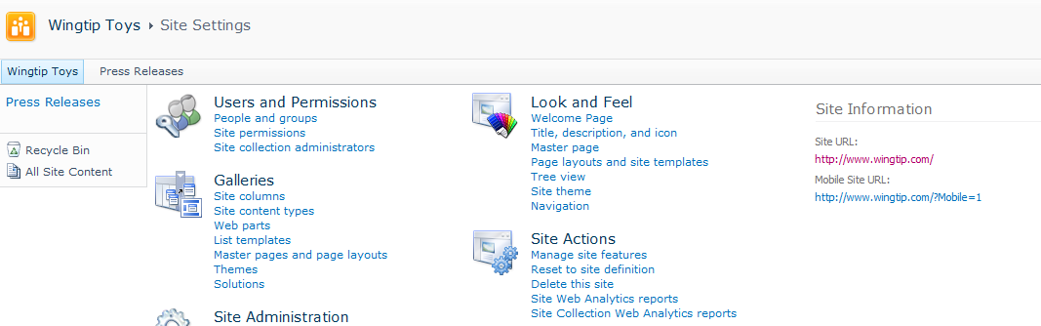
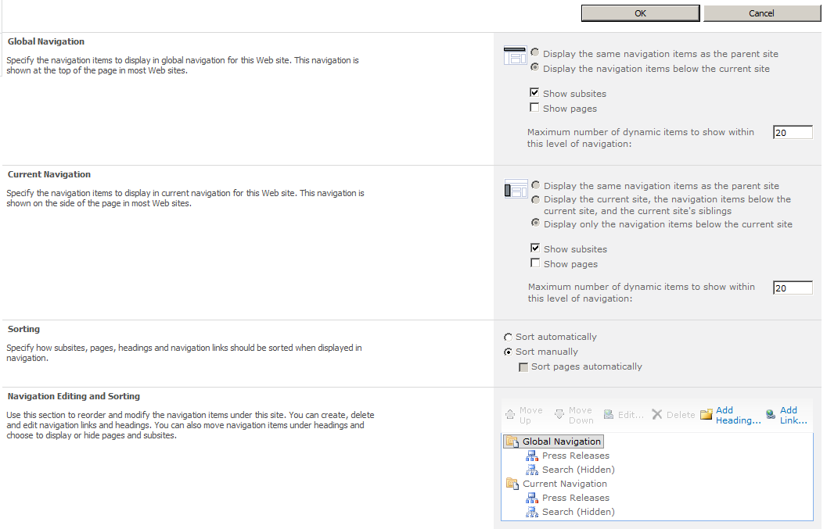
Configuring Navigation
Notes:
This slide shows the user interface experience for customizing the navigation in a publishing site. Note that this page is specific to just one site and you might have to navigate to this page in several child sites to customize navigation for the site collection as a whole.

Slide 32
DEMO
Configuring Navigation

Slide 33
Summary
Introduction to Publishing Sites
Publishing Site Taxonomy
Adding Pages and Sites
Configuring a Custom Master Page
Customizing Navigation

